Slide 2
Making your Windows Store app more reliable
Harry Pierson
Senior Program Manager, Runtime Experience Team
@devhawk
3-136

Slide 3
Good ratings and reviews are critical to the success of your Windows Store app.

Slide 4
Unreliability is the top reason why users give apps bad ratings and reviews.
Source: Apigee 2012 Mobile App Review Survey

Slide 5
Reliability is a continuing process.
Bad things happen to good apps.

Slide 6
Monitor and regularly improve the quality of your app in order to avoid the #1 cause of bad reviews.

Slide 7
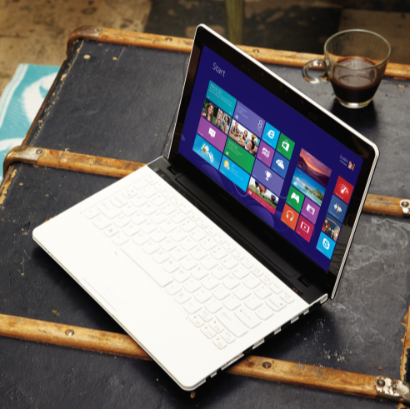
Agenda
Quality telemetry and the Windows Dev Center
Adding logging to your app
New Windows Runtime error and logging APIs
End-to-end demo

Slide 8
Regularly review your app’s quality telemetry on the Windows Dev Center.

Slide 9
Microsoft automatically collects analytics and telemetry data about your Windows Store app.

Slide 10
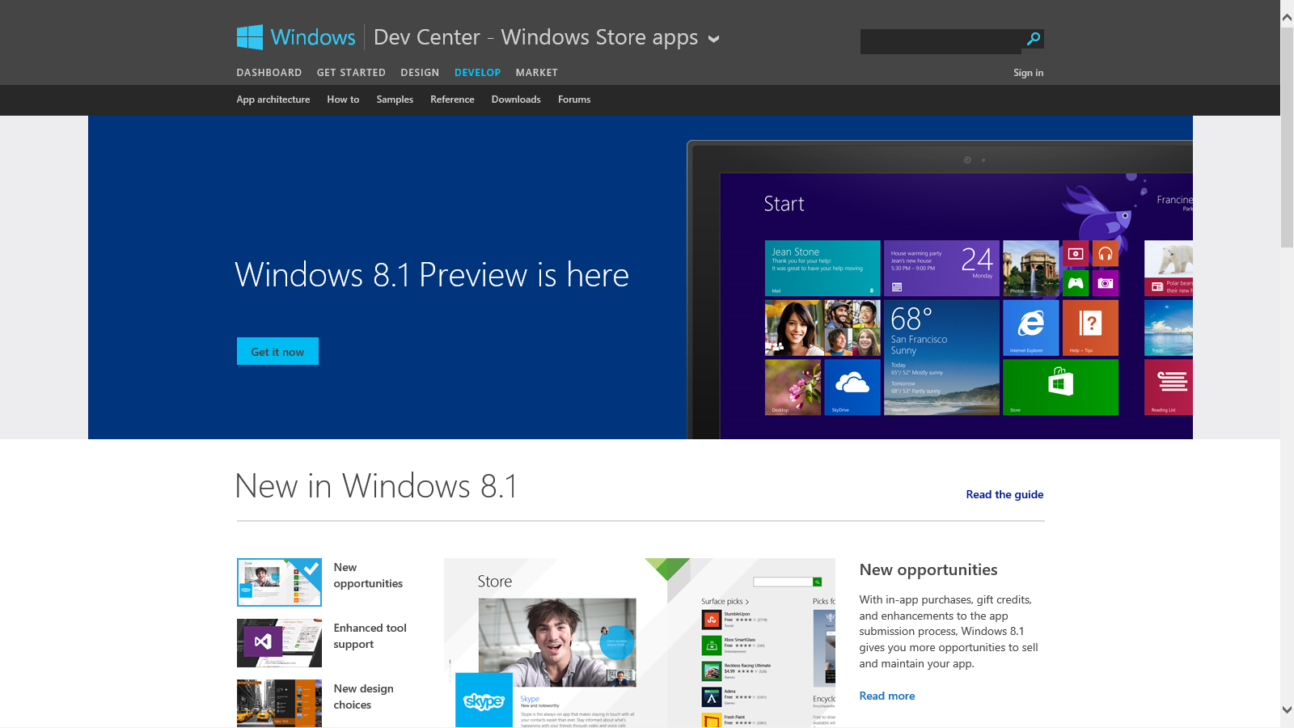

Slide 11
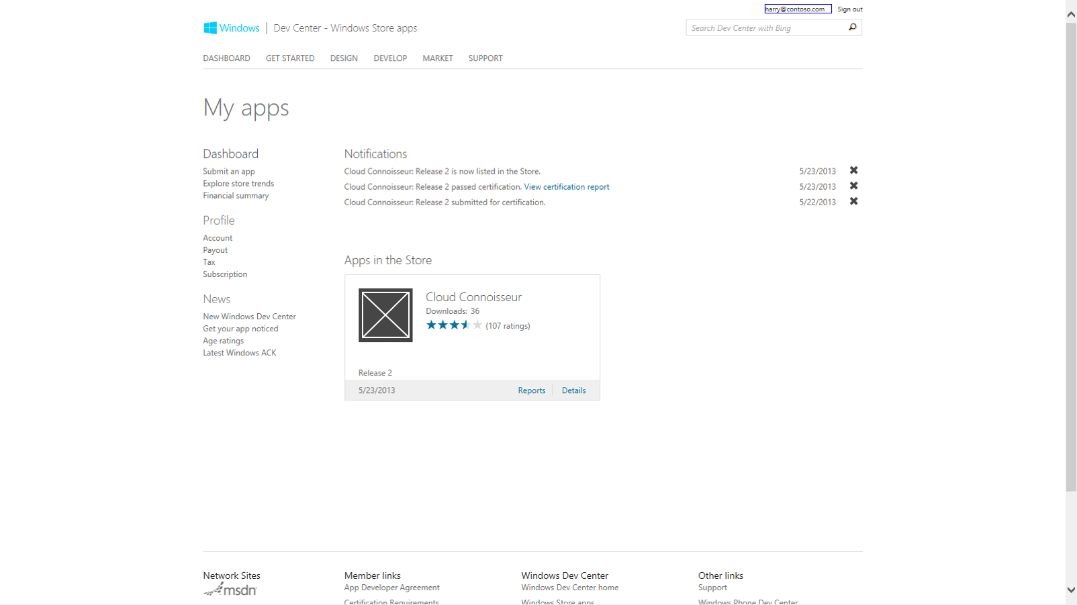

Slide 12
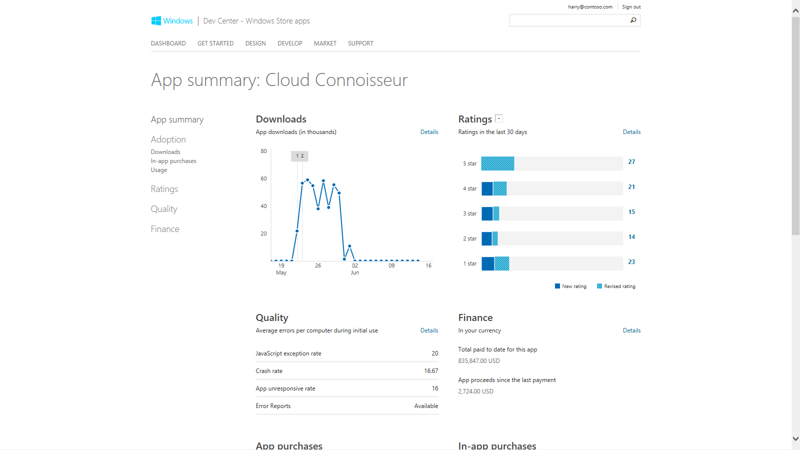

Slide 13
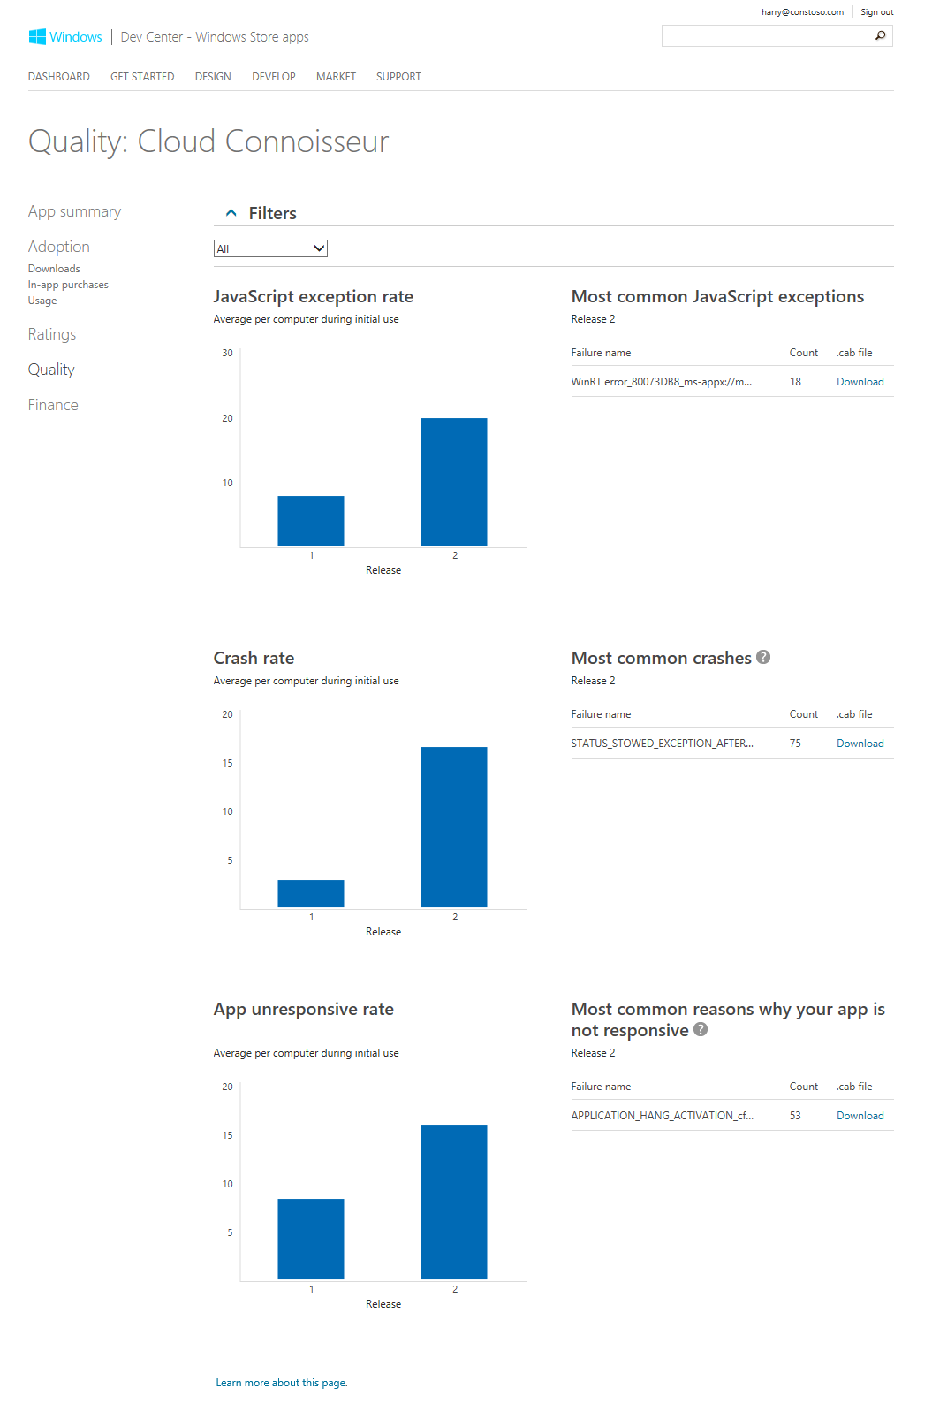

Slide 14
Error reports are not as useful as you might think.

Slide 15
Take advantage of the new logging and error APIs to keep track of what is happening inside your application.

Slide 16
Logs can provide temporal context needed to diagnose issues that occur on customers’ machines.
Windows 8.1 includes a new logging API that’s very simple to use.

Slide 17
Logging to memory
Keep a running log of recent events.
Save and send that log when an error is detected.
Logging Channel
Logging Channel
Circular Memory Buffer
Your Backend
Logging Session
Logging Channel
SaveToDiskAsync
Error
Logging Channel
Log File
Background Uploader

Slide 18
LoggingChannel example
var channel = new LoggingChannel ("ChannelName");
channel.LoggingEnabled += (sender, args) => {
_isLoggingEnabled = sender.Enabled;
_channelLoggingLevel = sender.Level; }
var channel = new LoggingChannel ("ChannelName");
channel.LoggingEnabled += (sender, args) => {
_isLoggingEnabled = sender.Enabled;
_channelLoggingLevel = sender.Level; }
var level = LoggingLevel.Error;
if (_isLoggingEnabled && level >= _channelLoggingLevel) {
channel.LogMessage("Message to log", level);
channel.LogValuePair("Count", 42, level); }

Slide 19
LoggingSession example
var session = new LoggingSession("Session Name");
session.AddLoggingChannel(channel, LoggingLevel.Warning);
//when error detected, save the log session to disk then upload
StorageFile logFile = await session.SaveToFileAsync(logFolder, name)
//background uploader code omitted

Slide 20
Logging to disk
Log all events to disk.
Send log file when file reaches a specified size.
Flush log memory buffer to disk on crash and send just like in the log to memory example.
Logging Channel
Logging Channel
File Logging Session
Logging Channel
Your Backend
Logging Channel
Memory Buffer
Log File
Log File
File Size Limit
reached
Background
Uploader

Slide 21
FileLoggingSession example
var session = new FileLoggingSession("Session Name");
session.AddLoggingChannel(channel, LoggingLevel.Warning);
session.LogFileGenerated += (senders, args) => {
//when file generated, move it so it doesn’t get overwritten
await args.File.MoveAsync(logFolder);
//background uploader code omitted
}
//Flush log to disk on demand
var file = await session.CloseAndSaveToFileAsync();

Slide 22
Windows 8.1 improves exception interop and provides a mechanism to observe unhandled errors before process termination.

Slide 23
Use XAML’s UnhandledException event if you wish, especially if you’re a managed developer. CoreApplication.UnhandledErrorDetected is better for C++ developers and logging components.

Slide 24
UnhandledErrorDetected example
CoreApplication.UnhandledErrorDetected += (sender, args) => {
try {
args.UnhandledError.Propagate();
}
catch (Exception ex) {
channel.LogMessage(ex.Message, LoggingLevel.Critical);
//code to save log and background upload omitted
throw;
}
};

Slide 25
XAML’s UnhandledException example
App.Current.UnhandledException += (sender, args) => {
channel.LogMessage(args.Exception.Message, LoggingLevel.Critical);
//code to save log and background upload omitted
};

Slide 26
Demo: Add logging code to my app

Slide 27
Monitor and regularly improve the quality of your app in order to avoid the #1 cause of bad reviews.

Slide 28
Summary
Regularly review your app’s quality telemetry on the Windows Dev Center. Log what is happening inside your application. Take advantage of new logging and error APIs in Windows 8.1

Slide 29
Related Sessions
2-138 – Improve Application Health by Leveraging Crash Analytics Collected from End Users
3-133 – Testing your C#-based Windows Store app: Top 10 areas to look for bugs
4-107 – Windows Runtime Internals: Understanding the threading model

Slide 30
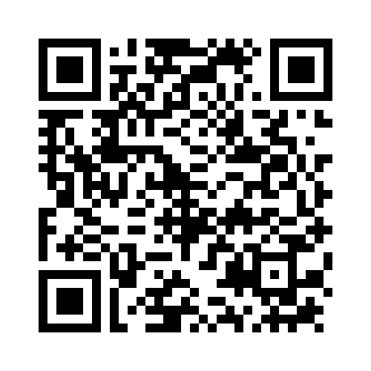
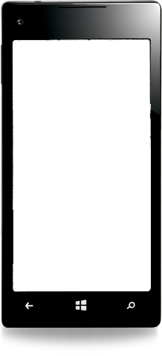
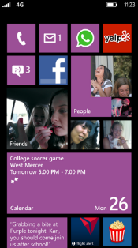
Evaluate this session
Required Slide
*delete this box when your slide is finalized
Your MS Tag will be inserted here during the final scrub.
Scan this QR code to evaluate this session and be automatically entered in a drawing to win a prize!

